Slide 1

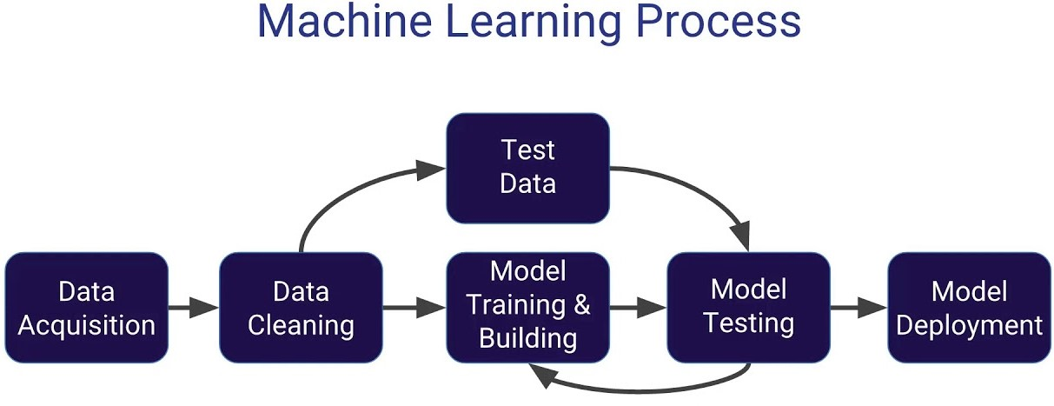
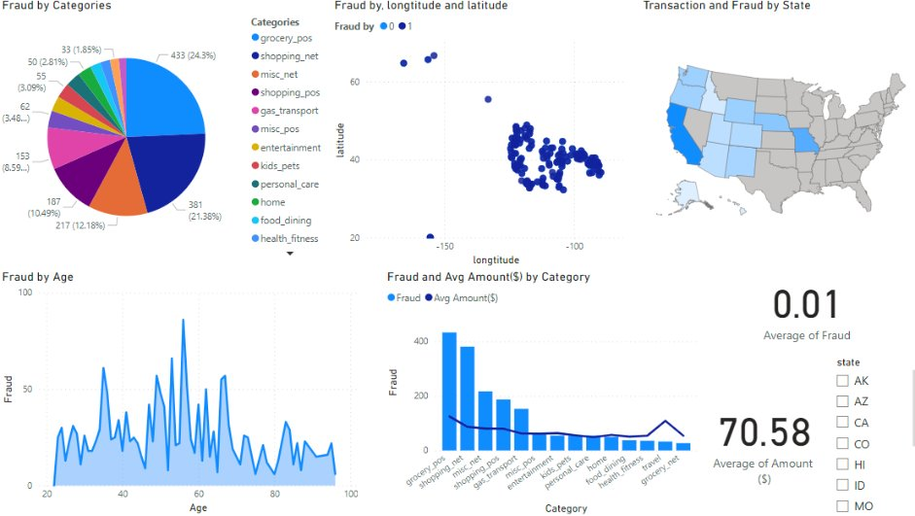
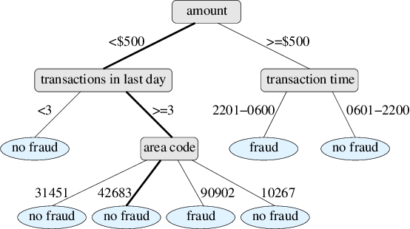
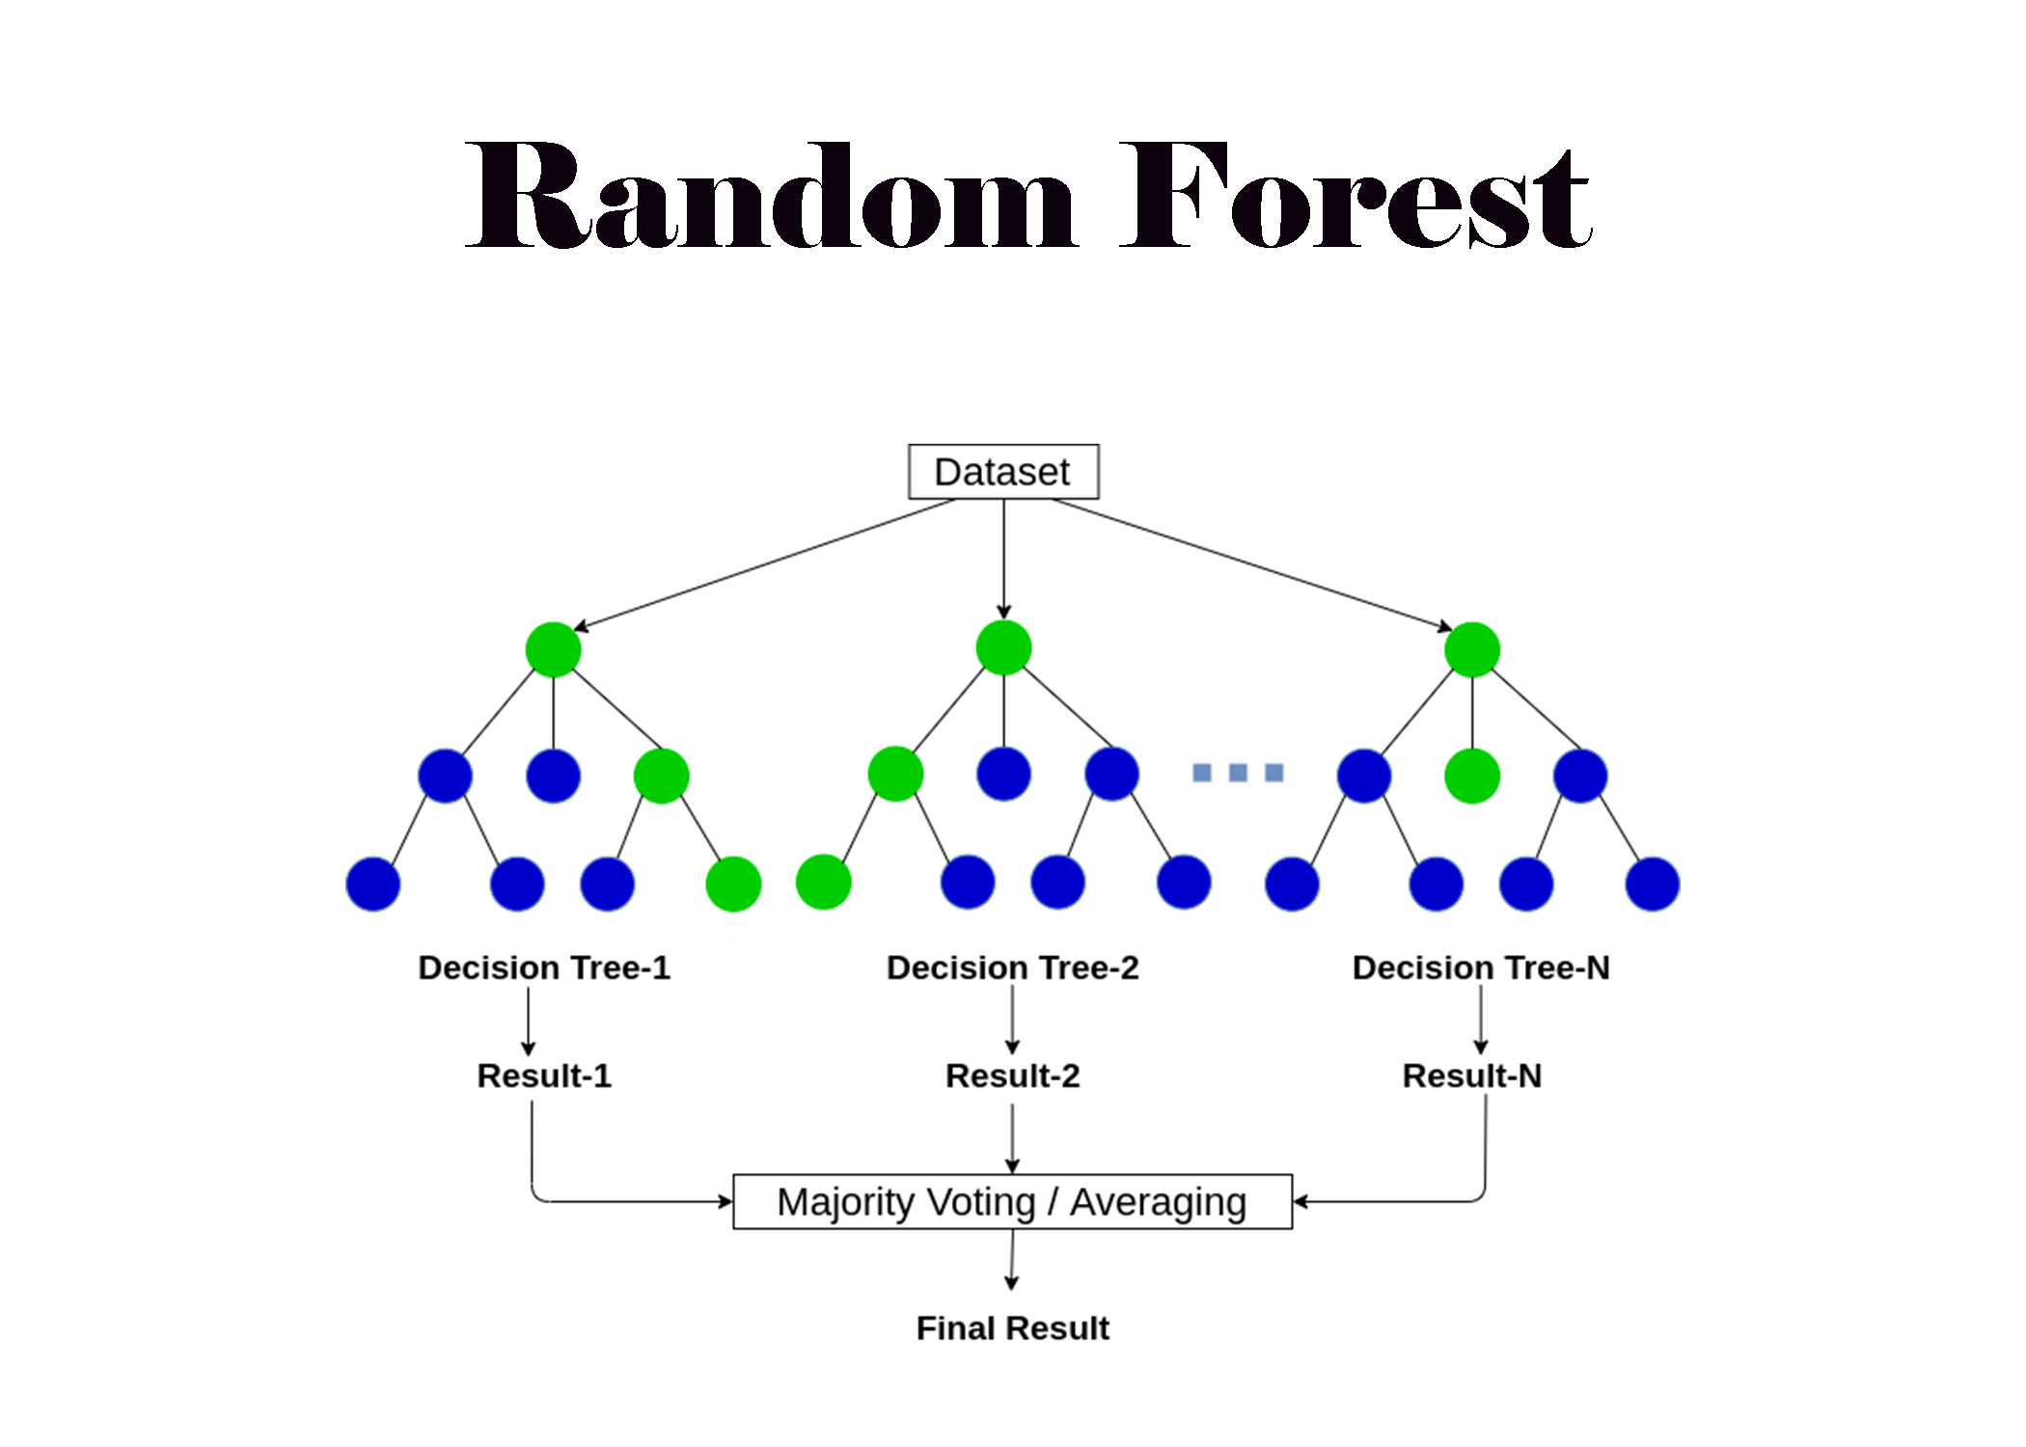






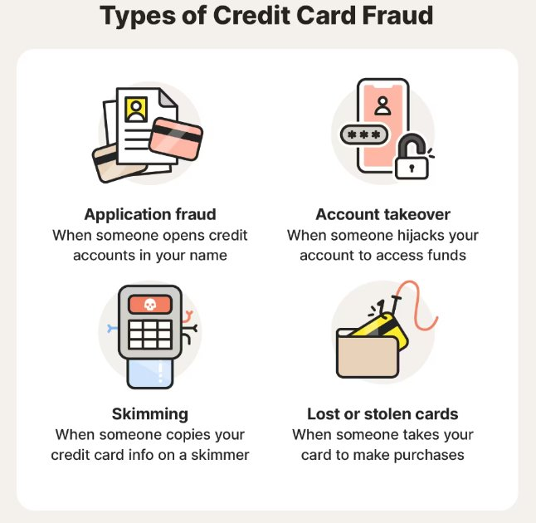
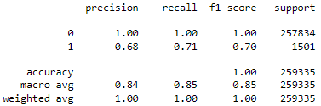
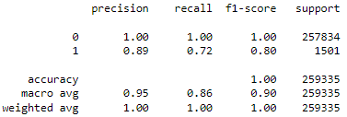

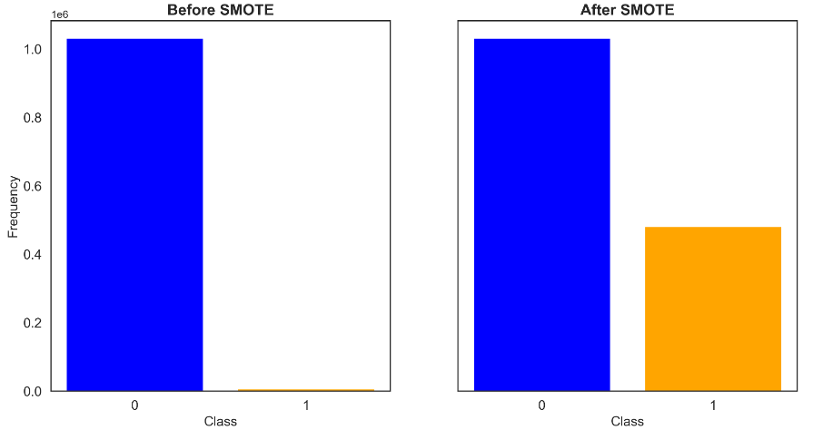
The Future of Fraud Prevention: Evaluating Predictive Models for Credit Card Transactions
Khoa Pham, Leo Gesto, Shin-Shyang Kao
University of the District of Columbia
Problem Statement
Approaches and Tools
Algorithms
The rise of digital transactions has led to an increase in credit card fraud, presenting substantial financial risks.
There is a critical need for a sophisticated system to detect and prevent such fraud, thus safeguarding consumer finances and securing digital transactions against unauthorized use.
A decision tree: a supervised machine learning algorithm that's effective for classification tasks, distinguishing between fraudulent and legitimate credit card transactions.
Random Forest: extends the decision tree concept by creating an ensemble of trees to improve the predictive performance and accuracy. For credit card fraud detection, a Random Forest system would analyze patterns and anomalies across numerous decision trees.
Introduction and Backgrounds
Technique
Results
Credit card fraud encompasses a wide range of illegal activities involving the unauthorized use of a credit card to purchase goods or services.
Synthesize elements for the minority class. SMOTE works by selecting examples that are close in the feature space, drawing a line between the examples in the feature space and drawing a new sample at a point along that line.​
Decision Tree
Random Forest
This report presents our senior project, focused on designing an advanced system for detecting credit card fraud, crucial for the safety of digital transactions.
Leveraging visual analytics and sophisticated data analysis, our goal was to develop an efficient detection mechanism.
Our analysis is based on a dataset of over 1 million entries from Kaggle, aimed at identifying fraudulent transactions effectively.
Robust Accuracy: Achieved a 99.78% accuracy rate, demonstrating our model's effectiveness in detecting and preventing credit card fraud.
Financial Institutions: Reduced operational and fraud-related costs, enhancing financial efficiency and security.

